Slide 1

Key Stage 2 SATs
Presentation to Parents
9th February 2022

Slide 2
What are SATs and why do we have them?
SATs (Standard Attainment Tests) take place at the end of year 6 and are designed to test pupils’ knowledge and understanding of the Key Stage 2 programme of study.
All year 6 children across the country are tested in English (reading, writing, grammar and punctuation) and Maths and this gives the government a clear picture of what standards look like.
It also helps parents compare their child’s progress with children of the same age nationally.
This is the first year since 2019 that the tests have taken place. Results will be made available to schools in July. However, this data will not be used for ‘performance tables’ this year.

Slide 3
The Tests – what will my child have to do?
Key Stage 2 SATs take place nationally in the week commencing 9th May 2022
Monday 9th May:
English grammar, punctuation and spelling test (SPAG)
Paper 1 – short answers (45 minutes)
Paper 2 – spelling (approximately 15 minutes)
Tuesday 10th May:
Reading test (60 minutes)
Wednesday 11th May:
Maths tests:
Paper 1 - arithmetic (30 minutes)
Paper 2 - reasoning (40 minutes)
Thursday 12th May:
Maths test:
Paper 3 – reasoning (40 minutes)
All tests are externally marked.
Writing is teacher assessed and moderated internally and may be externally moderated.
Science is teacher assessed.

Slide 4
Assessment and Reporting
What happens to the tests?
Tests are sent for external marking.
School will receive the results in July.
Parents will be given a copy of their child’s test results and teacher assessments.
The results of the school are used to inform school ‘performance tables’.
What do the results mean?
It is important to understand that children cannot ‘fail’ SATs.
The information is used as a snapshot of where children across the country are currently working.
From 2016 onwards, the raw score from each test is converted into a scaled score and each child will receive an overall result indicating whether or not they have achieved the required standard on the test.

Slide 5
Scaled Scores
What is meant by ‘scaled scores’?
It is planned that 100 will always represent the ‘national standard’.
Each pupil’s raw test score will therefore be converted into a score on the scale, either at, above or below 100.
Using the scaled score, the lowest a child can score is 80, with the highest being 120.
A child who achieves the ‘national standard’ (a score of 100) will be judged to have demonstrated sufficient knowledge in the areas assessed by the tests.
Each pupil receives:
a raw score (number of raw marks awarded);
a scaled score in each tested subject;
confirmation of whether or not they attained the national standard.

Slide 6
Scaled Score Examples
On publication of the test results in July:
A child awarded a scaled score of 100 is judged to
have met the ‘national standard’ in the area judged by the test
If a child’s score is above 110, they are working beyond
(or above) the expected national standard.
A child’s score is close to 80, they are judged to have not
yet met the national standard and performed below the
expectation for their age.

Slide 7
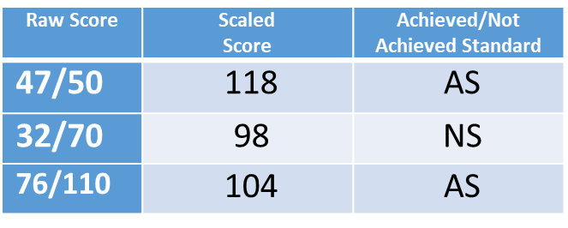
Assessment and Reporting
What the codes mean:
For the test results in reading, grammar, punctuation and spelling and maths your child will have received either the code:
AS (Achieved Standard) or NS (Not Achieved Standard)
Scaled Scores:
We also include the scaled score for your child for each test below.
A scaled score of 100 represents the expected standard for each test. A scaled score of 100 or above means your child ‘Achieved Standard’. A score of less than 100 means your child did ‘Not Achieve Standard’. The highest scaled score possible is 120 and the lowest is 80.
Reading:
Grammar, punctuation and spelling:
Maths:

Slide 8
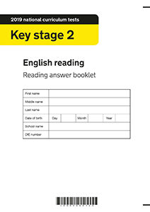
Reading

Slide 9
Reading overview
The reading test consists of a single test paper with three unrelated reading texts. Children are given 60 minutes in total, which includes reading the texts and answering the questions.
A total of 50 marks are available.
Questions are designed to assess the comprehension and understanding of a child’s reading.
During the reading paper, a child’s inference and deduction skills are thoroughly tested. They will also be expected to answer questions on authorial choices: explaining why an author has chosen to use particular vocabulary, grammar and text features.
Some questions are multiple choice or selected response; others require short answers and some require an extended response or explanation.

Slide 10
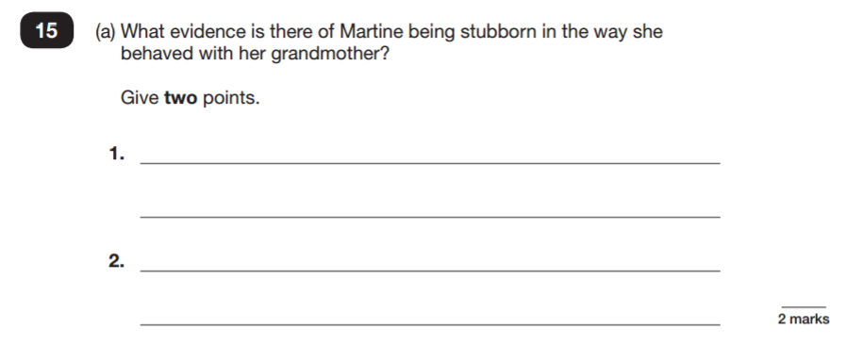
Sample Questions
Reading Paper

Slide 11
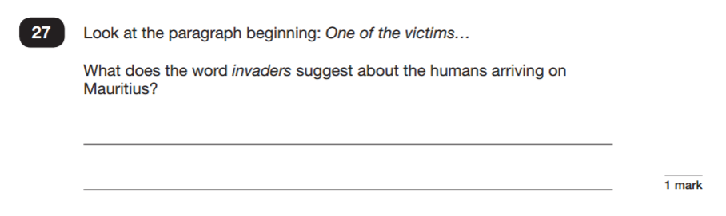
Sample Questions
Reading Paper

Slide 12
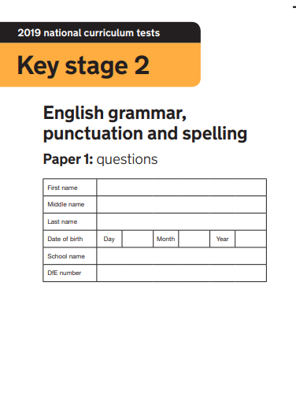
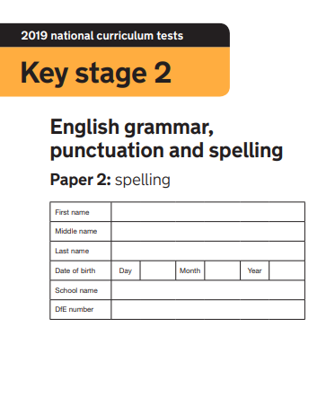
Grammar, Punctuation & Spelling

Slide 13
Grammar, Punctuation & Spelling overview
A spelling test is administered containing 20 words, which lasts approximately 15 minutes. A total of 20 marks are available.
A separate test is given on grammar, punctuation and vocabulary.
This test lasts for 45 minutes and requires short answer questions including some multiple choice. A total of 50 marks are available.
Marks for these two tests are added together to give a total for grammar, punctuation and spelling. A grand total of 70 marks are available.

Slide 14
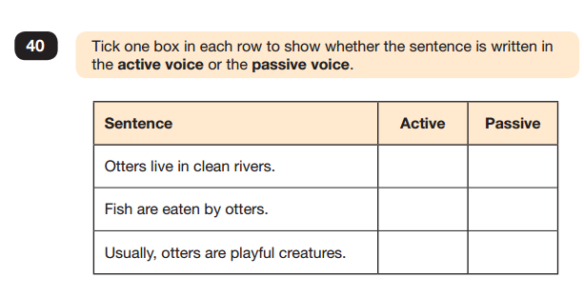
Sample Questions
Grammar, Punctuation and Spelling Paper 1

Slide 15
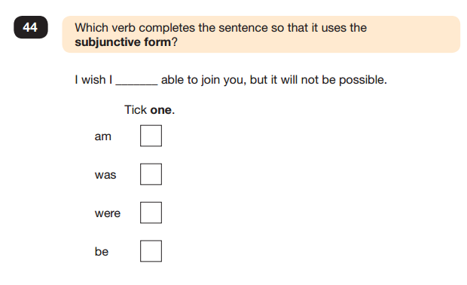
Sample Questions
Grammar, Punctuation and Spelling Paper 1

Slide 16
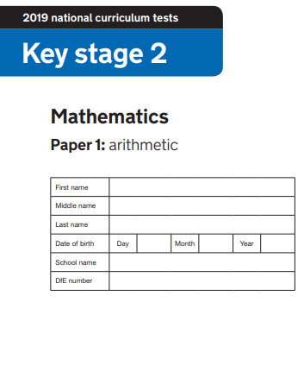
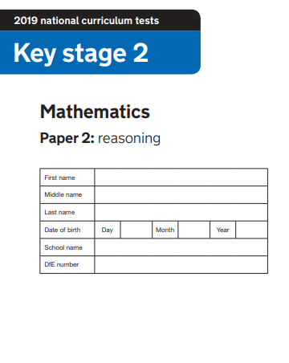
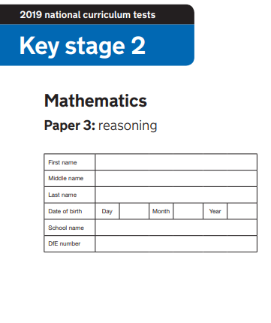
Mathematics

Slide 17
Mathematics Overview
Children will sit three tests: paper 1, paper 2 and paper 3. Total 110 marks.
Paper 1 is for arithmetic lasting for 30 minutes, covering calculation methods for all operations, including use of fractions, percentages and decimals. 40 marks
Questions gradually increase in difficulty. Not all children will be expected to access some of the more difficult questions later in the paper. Speed is of the essence with this paper.
Papers 2 and 3 cover problem solving and reasoning, each lasting for 40 minutes. 35 marks per paper
Pupils will still require calculation skills but will need to answer questions in context and decide what is required to find a solution.

Slide 18
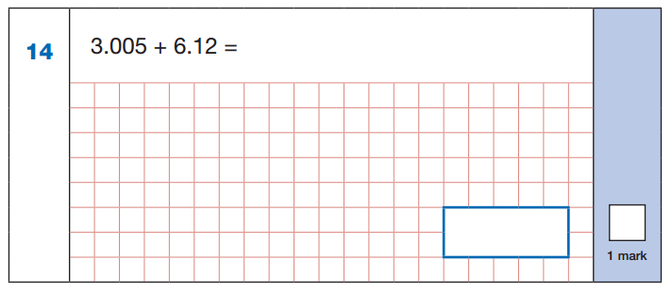
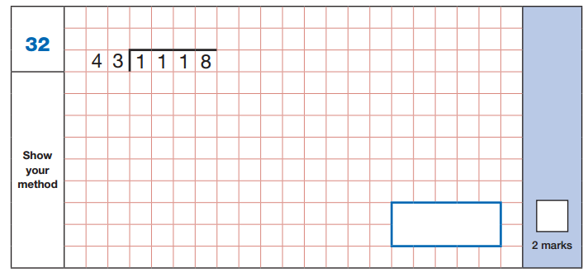
Sample Questions
Maths Paper 1: Arithmetic

Slide 19
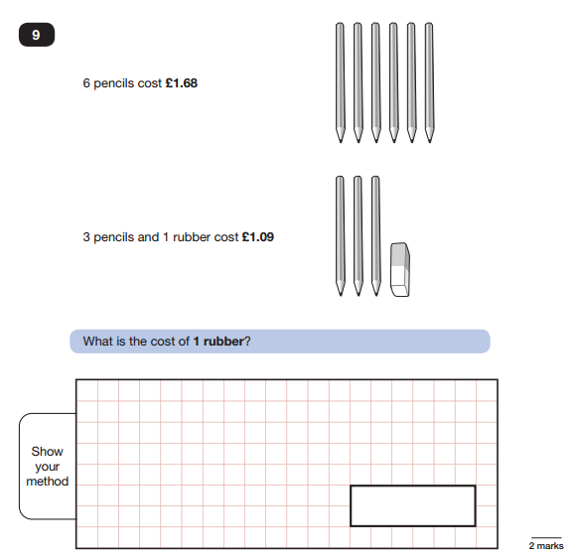
Sample Questions
Maths Paper 2 / Paper 3 : Reasoning

Slide 20
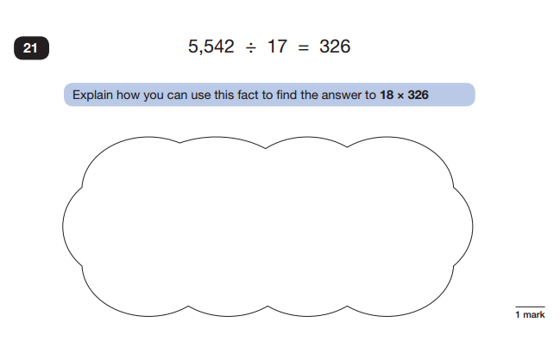
Sample Questions
Maths Paper 2 / Paper 3 : Reasoning

Slide 21

Helping the Children

Slide 22
Help from school
Planned approach
Positive approach with a sense of perspective
Targeted learning in school
Looking at past SATs papers and SATs questions
Learn the ‘tricks’ of how to succeed in tests
Homework – GCP books

Slide 23
How to Help Your Child – in the build up
Support your child in helping prepare them for the tests – but don’t overdo it.
Explain that SATs are a way of showing off what they can do – and they cannot fail.
Make learning as fun as possible.
Give your child the opportunity to talk about any concerns.
Help them with any homework.
Encourage them to be confident in their ability – they have been working hard in school.
Encourage them to continue working hard – effort is the route to success.

Slide 24
How to Help Your Child – SATs week
Make sure your child is in school every day of SATs week.
Help them to get to school on time every day - the tests start first thing in the morning.
A good night's sleep before each test.
A good breakfast each morning.
Healthy snacks to have in between or after the tests.
In the evenings of SATs week, keep any work you do at home short.

Slide 25
Any questions?

Slide 26
Thank you for coming.

